Slide 1
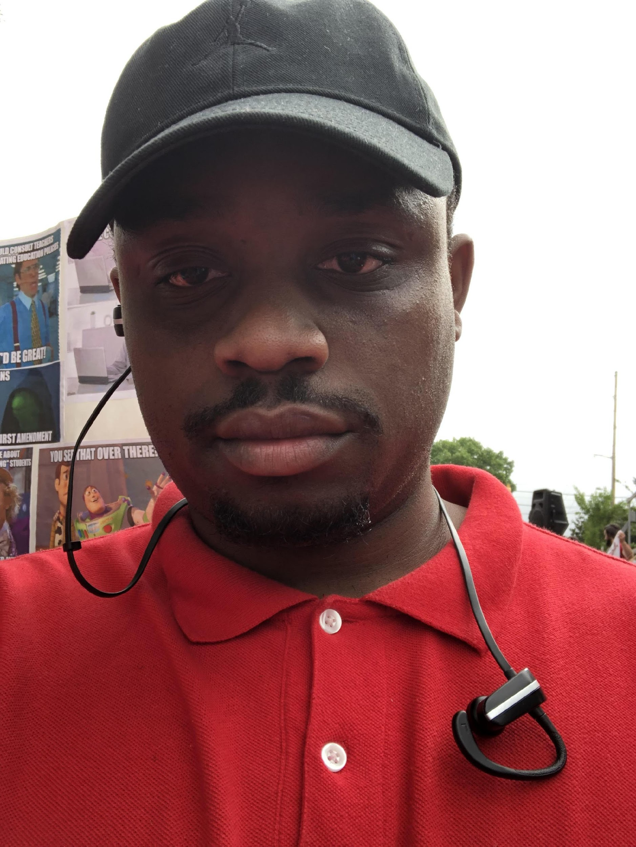
MR. GALEN JENKINS 7TH GRADE ELA/SS TEACHER

Slide 2
MY CONTACT INFORMATION
jenkiga@richmond.k12.ga.us
https://www.rcboe.org/Domain/16171
IRemind passcode: mrjenkins0
School Number 706-737-7288

Slide 3
DAILY SCHEDULE
Student drop off- 8:50
Extended Learning Time (ELT)- 09:20 – 09:50
1st/2nd Period Connections -09:55 – 11:25
3rd Period- ELA- 11:30 - 12:55
Lunch- 12:20 - 12:50
4th Period- ELA/SEL- 12:55 - 02:15
5th Period- ELA- 02:15 - 03:10
6th Period- Social Studies- 03:10 - 04:05
Car Rider pick up- 4:05

Slide 4
CHECKOUT MY WEBSITE TO VIEW THE FOLLOWING INFORMATION
Week At A Glance (WAG)
Class Syllabus/Supply List
Resources
Additional Information

Slide 5
ARRIVAL AND DISMISSAL
Morning Arrival
Drop off your child on Dragon Way behind your school
Morning Drop off time for car riders 8:50 A.M.
Early drop off students are unsupervised.
Please remain with your child until 8:50 A.M. when teachers report for duty.
Afternoon Dismissal
Bus Riders will report to bus loading zone
Walkers are dismissed from the bus loading zone where the crossing guard is located
Car Riders pick up time is 4:05 P.M.

Slide 6
RCSS LEARNING PLATFORM AND CANVAS
New to the Richmond County
Go to rcboe.org
Click Student
Click Launch Pad
Your child will login through Launch Pad to access RCBOE Canvas.
Click link to watch Tutorial Video
https://www.rcboe.org/Domain/16265

Slide 7
THANK YOU FOR VISITING JOHN M. TUTT MIDDLE SCHOOL! Be ready for open house August 3rd, 2022. School will start back August 8th!

